Slide 1
Obscure Python Implementations

Slide 2
What do we talk about when we talk about Python?
Ans: Usually CPython

Slide 3
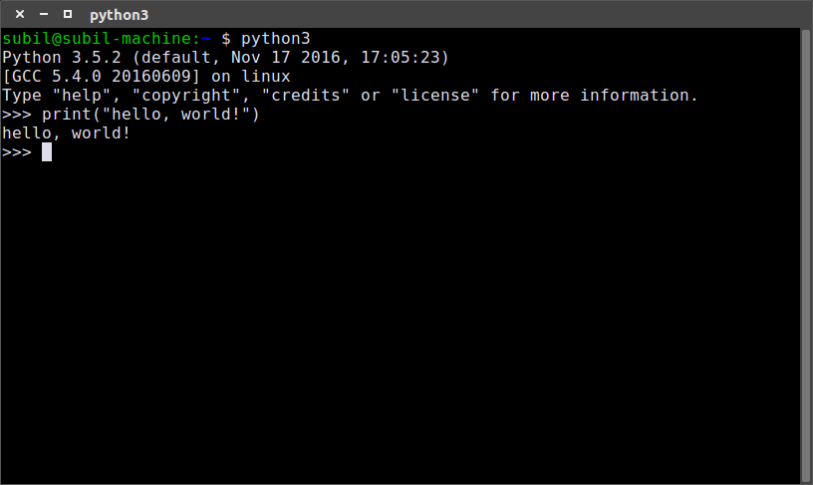
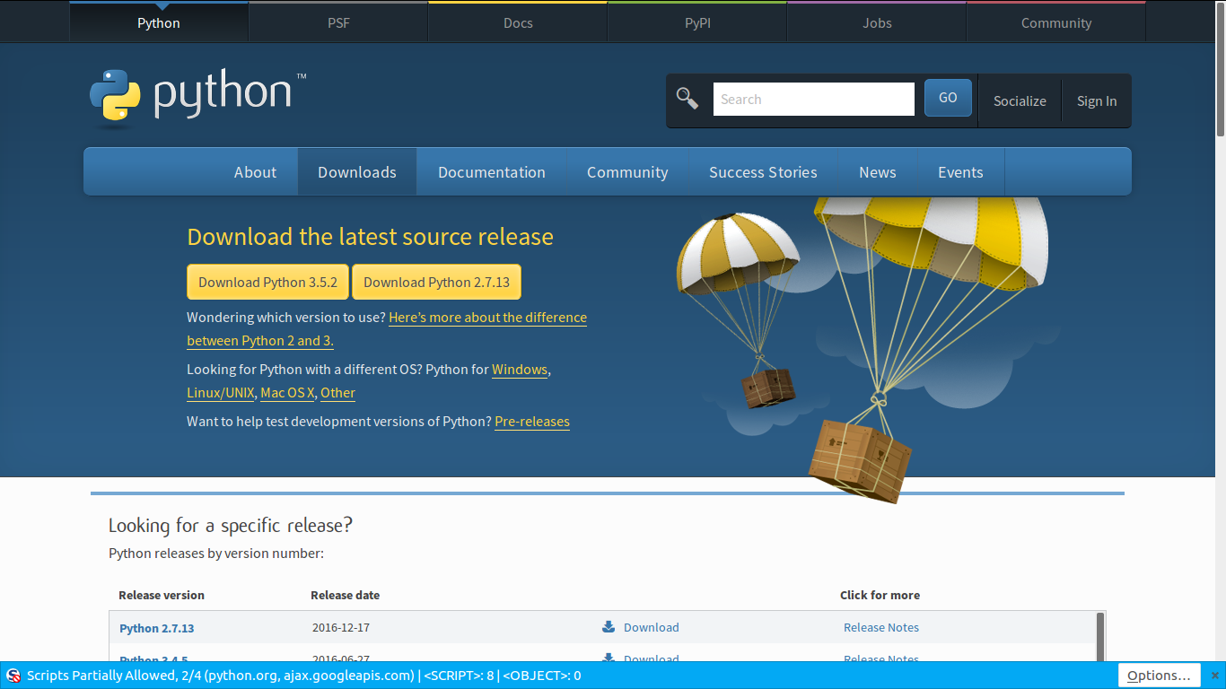

Slide 4
Language Specification vs
Implementation
Specification: Set of rules and concepts about the language
Implementation: A computer program that that implements those rules

Slide 5
First: The not-so-obscure Python Implementations

Slide 6
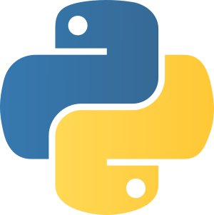
CPython
Reference implementation
Developed by Guido van Rossum and Co
2 major versions: Python2 and Python3
Written in C
You can write C extensions

Slide 7
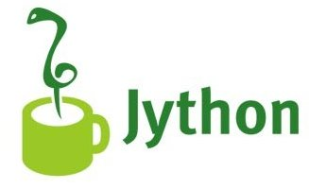
Jython
Written in Java
Runs on the JVM
Can interoperate with Java
Useful scripting language for the JVM

Slide 8
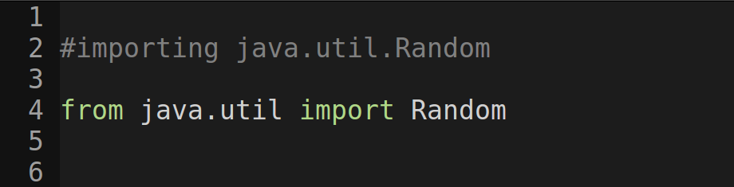
Jython

Slide 9

IronPython
Written in C#
Runs on the CLR (the .NET framework)
Similar goals as Jython
Can use .NET assemblies

Slide 10
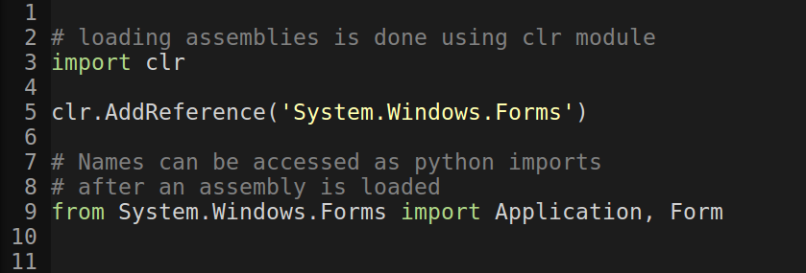
IronPython

Slide 11

PyPy
A very fast implementation of Python
Much faster than CPython
Uses a JIT compiler
Written in a typed, restricted subset of Python, called RPython

Slide 12
PyPy
So basically its Python written in another (albeit restricted) implementation of Python
And somehow its faster than Cpython!
Explaining this probably requires another talk

Slide 13
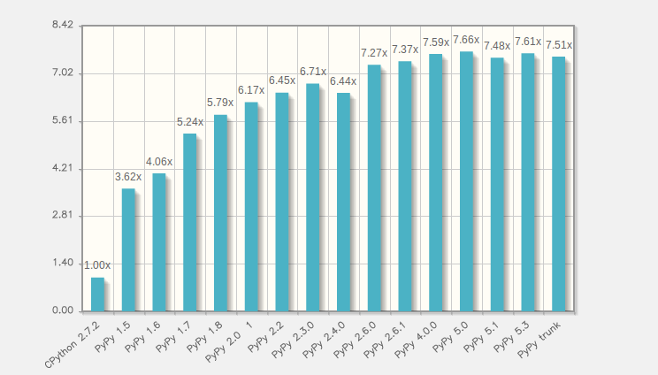

PyPy vs CPython

Slide 14

This is a picture of Hagrid
(for no reason)

Slide 15
Now for the obscure
Python Implementations

Slide 16

Nuitka
A Python compiler
Fully compatible with Python 2.6, 2.7, 3.2 – 3.5
Aims to be a drop-in replacement for CPython

Slide 17
Uses for Nuitka
Can create standalone executables
It just works
Give your program to someone else
Create extension modules
Create fast C extensions without needing to use C!

Slide 18
Rough overview

Slide 19
DEMO

Slide 20
Stackless Python
Provides microthreads
Managed by the interpreter
INTERPRETER
OS
~
~
~

Slide 21
Stackless Python
Provides microthreads
Managed by the interpreter
Less overhead than OS threads
INTERPRETER
~
~
~
OS

Slide 22
Stackless Python
Doesn’t use the C call stack
Uses heap memory instead

Slide 23
What does this mean?
PING
PONG
PING
PONG
PING
Stack

Slide 24
What Stackless Python does
ping()
pong()
pong_channel
ping_channel

Slide 25
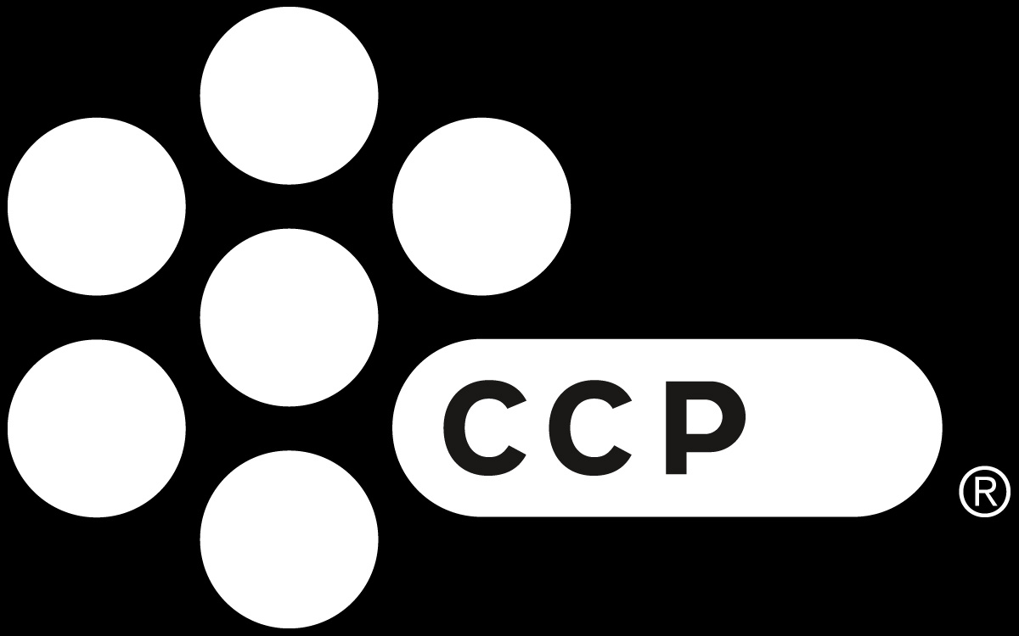
Who uses it?

Slide 26

Who uses it?

Slide 27

Brython
Stands for “Browser Python”
It’s a JS library to allow Python for scripting on the web
Comes with a built-in DOM API

Slide 28
Brython disadvantages
Compiler doesn’t optimise
No established integration to existing web dev workflows (yet)
  They’re working on it

Slide 29
THANK YOU!

Slide 30

Questions?
Every question gets a Harry Potter meme!

Slide 31


Slide 32


Slide 33


Slide 34


Slide 35


Slide 36


Slide 37


Slide 38
Find slides at
github.com/dragsubil/talks

Slide 39

MERRY CHRISTMAS

